Slide 1
Standards of Care for people living with NTM disease
What are they? And why do they matter?
Version 1
September 2024

Slide 2
What are the NTM Standards of Care?
The Standards of Care are a written guide to the minimum level of care that people with NTM disease should expect to receive from the NHS. They are not guidelines.
They comprise 33 quality statements, covering six key themes that address the most important issues for the care of people with both NTM pulmonary and extrapulmonary NTM disease.
Person-centred care
Presentation & diagnosis of NTM disease
Treatment decisions &
multidisciplinary support
Monitoring & review
Well-being & prevention
of secondary infection
Research & education
The Standards of Care have been produced by NTM Network UK in partnership with healthcare professionals, people living with NTM disease, and professional associations.
They have been derived from the published guidelines and expert opinion.

Slide 3
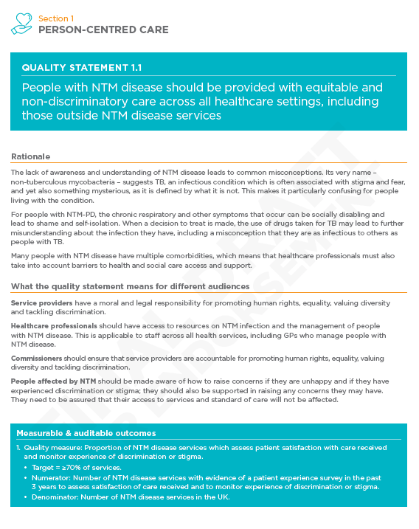
Structure of each quality statement
Quality statement
Rationale
What the quality statement means for different audiences
Service providers
Healthcare professionals
Commissioners
People affected by NTM (both people with NTM infection and/or disease, and their care community)
Measurable & auditable outcomes

Slide 4
Why do they matter?
There is an urgent need for consistent, standardised, high-quality care to be provided to people with NTM disease in the UK, irrespective of where they are managed.
The implementation of these Standards is expected to enhance diagnostic accuracy, streamline treatment pathways, and significantly improve patient outcomes.
For psychologists
The Standards of Care emphasise the vital role of psychologists in the management of NTM disease.
They advocate for the assessment of psychological well-being alongside physical parameters and the signposting of patients to appropriate support.
They highlight how integral psychologists are to a multidisciplinary team, collaborating with dietitians, physiotherapists, and other healthcare professionals to provide comprehensive care.

Slide 5
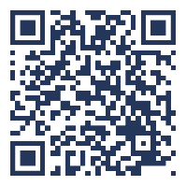
Where can I find them?
The Standards of Care can be downloaded from the Network’s website:
https://www.ntmnetworkuk.com/standards-of-care
Who are NTM Network UK?
NTM Network UK is a large alliance of over 500 healthcare professionals, public health scientists and research scientists from 200 centres across the UK.
Our key goal is to provide evidence to improve the quality of care for people with both NTM pulmonary disease and extrapulmonary NTM disease.
NTM Network is a charity registered with the Charity Commission for England and Wales (1207531). As such, we are dependent upon donations and funding to continue our work.
Visit us: www.ntmnetworkuk.com
Contact us: admin@ntmnetworkuk.com

